Slide 1
ANGANWADI MANAGEMENT SYSTEM
presented By
SHILPA K P
MCA B.Batch

Slide 2
DESCRIPTION
Integrated child development services(ICDS) is a government program in India which provide food,preschool education, primary health care,immunization,health check-up and other services. This scheme was launched in 1975.Aganavadi Management System is a android project for Automate All the Anganwadi services. Through this system conducting regular quick surveys of all families, organizing pre-school activities, providing health and nutrition education to families, organizing social awareness programmes. Child Development Project Officer of the village, visits the centre every month to monitor whether the women, pregnant women and the small children are getting their daily nutrition and education or not. Anganwadi workers are supervised by one supervisor. Health centers provide waxination ,polio, tablet to each anganwdies.Services such as ”GRAMASABHA” announcement are provided by panchayath.

Slide 3
EXISTING SYSTEM
There are many problems in the existing system of anganwadies . The Anganwadi system is mainly managed by the Anganwadi worker. She is a health worker chosen from the community and given 4 months training in health, nutrition and child-care.
The problems are :
Misuse of food given by government by worker.
Government is spending a huge amount for welfare of children, but If see the position of anganwadi’s in some villages, it is evident that this money is eaten away by people in between.
School is present but teachers visit only for 3 to 4 days in amounting some villagers
Giving rude answers to the questions asked by villagers.
Selling the food to shop keepers and earning money.

Slide 4
PROPOSED SYSTEM
The Ministry of Women Development and Child Welfare has laid down guidelines for the responsibilities of Anganwadi workers. These guidelines include showing community support and active participation in executing this program, conducting regular quick surveys of all families, organizing pre-school activities, providing health and nutrition education to families, educating teenage girls and parents by organizing social awareness programs.
Through the Anganwadi system, the country is trying to meet its goal of providing affordable and accessible healthcare to local populations.
Anganwadi workers have the advantage over the physicians living in the same rural area, which gives them insight into the state of health in the locality and assists in identifying the cause of problems and in countering them. They also have better social skills and can therefore more easily interact with the local people. As locals, they know and are comfortable with the local language and ways, are acquainted with the people, and are trusted.

Slide 5
MODULE DESCRIPTION
USER MANAGEMENT
Registration & Login
Teacher , parent -> add, update, delete
EVENT SCHEDULING
CDPO -> Meeting , announcement, allocate duties
Health Inspector -> add medical activities
TEACHER ACTIVITIES
Attendance details, food supply

Slide 6
SOFTWARE REQUIREMENT
Front End : Android
Back End : My SQL , PHP
Web Server : Xamp
IDE : Android Studio

Slide 7

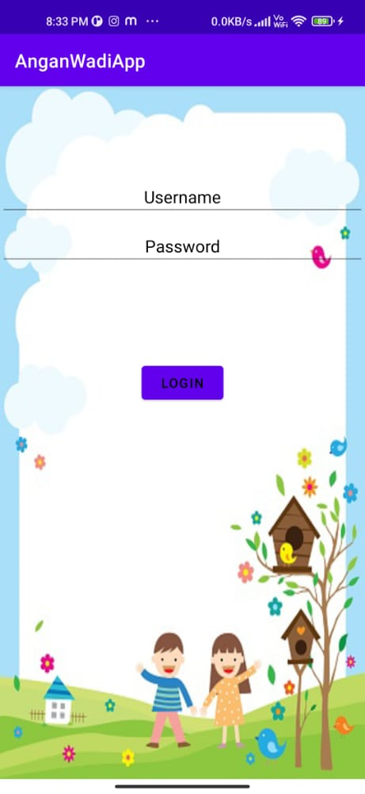
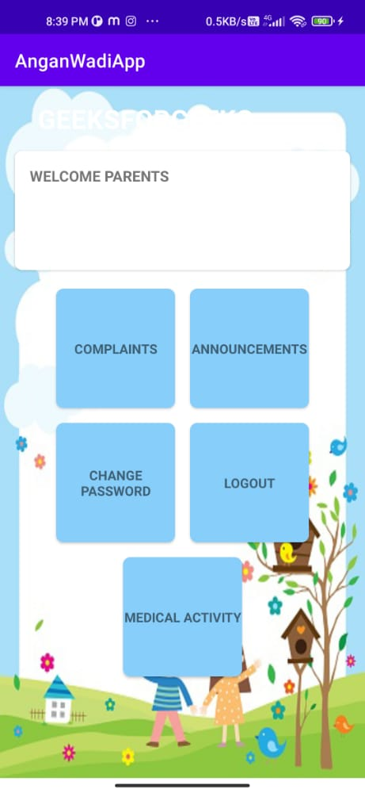
SCREEN SHOTS
ANDROID

Slide 8
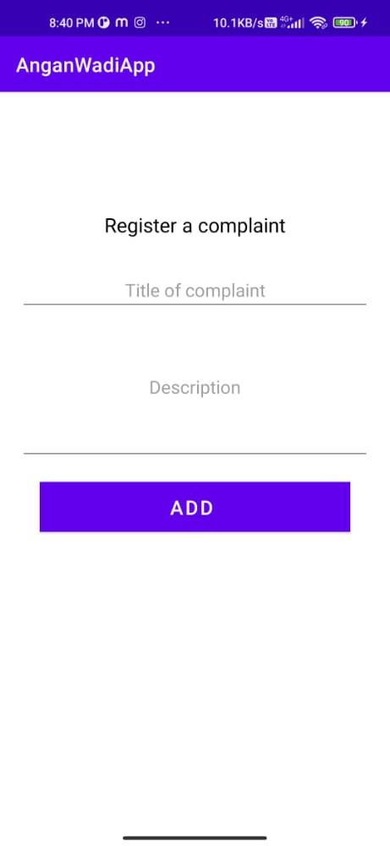
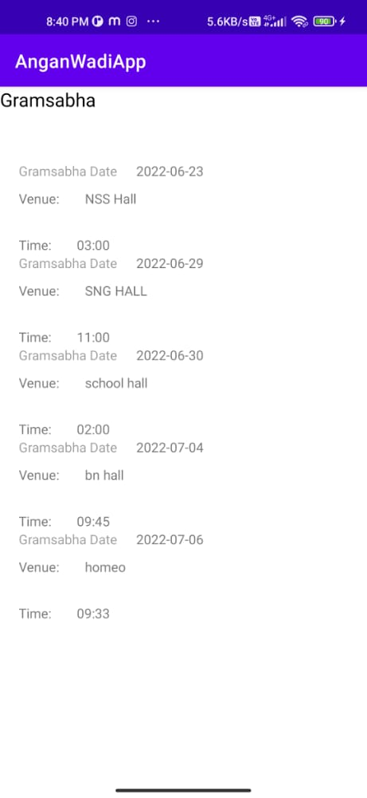
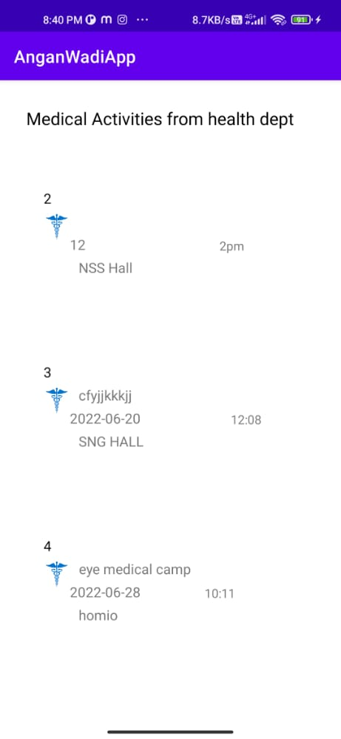

Slide 9
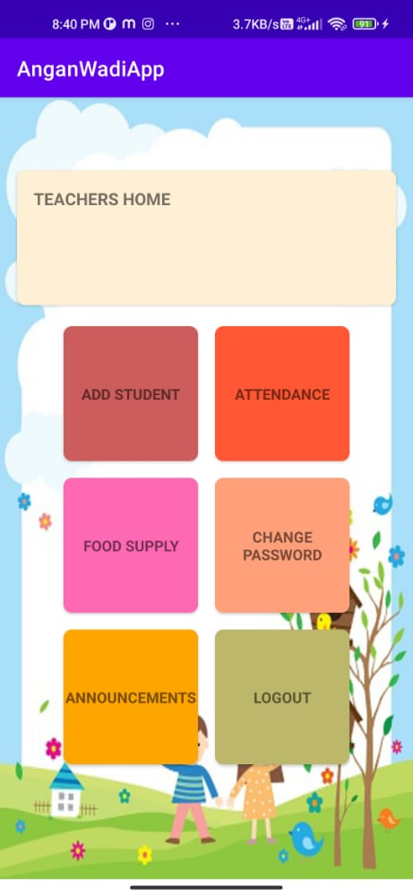
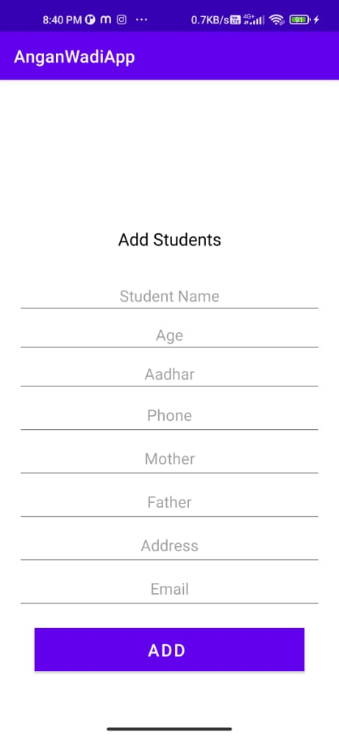
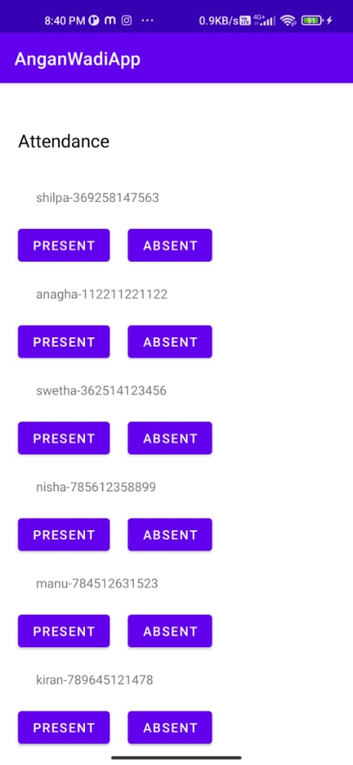

Slide 10
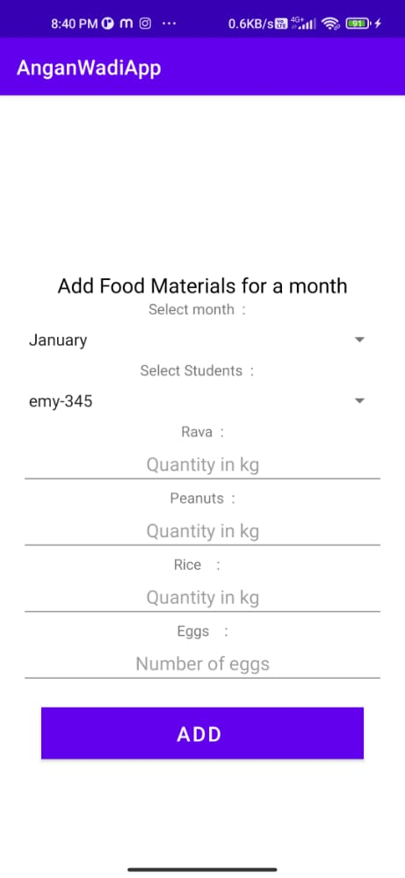
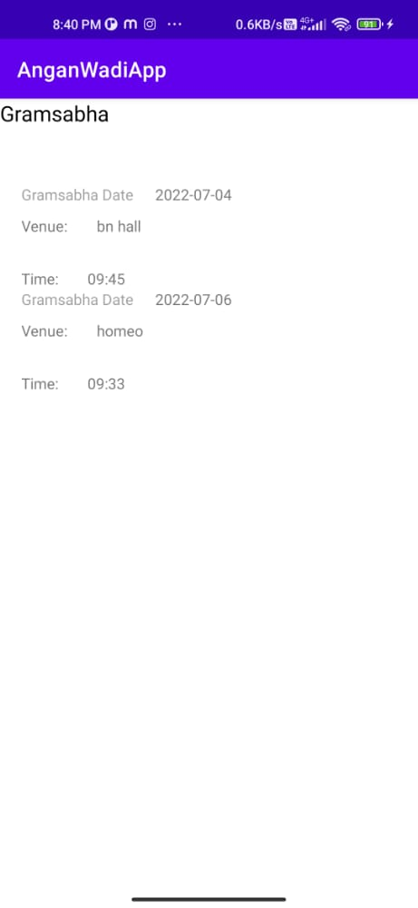

Slide 11
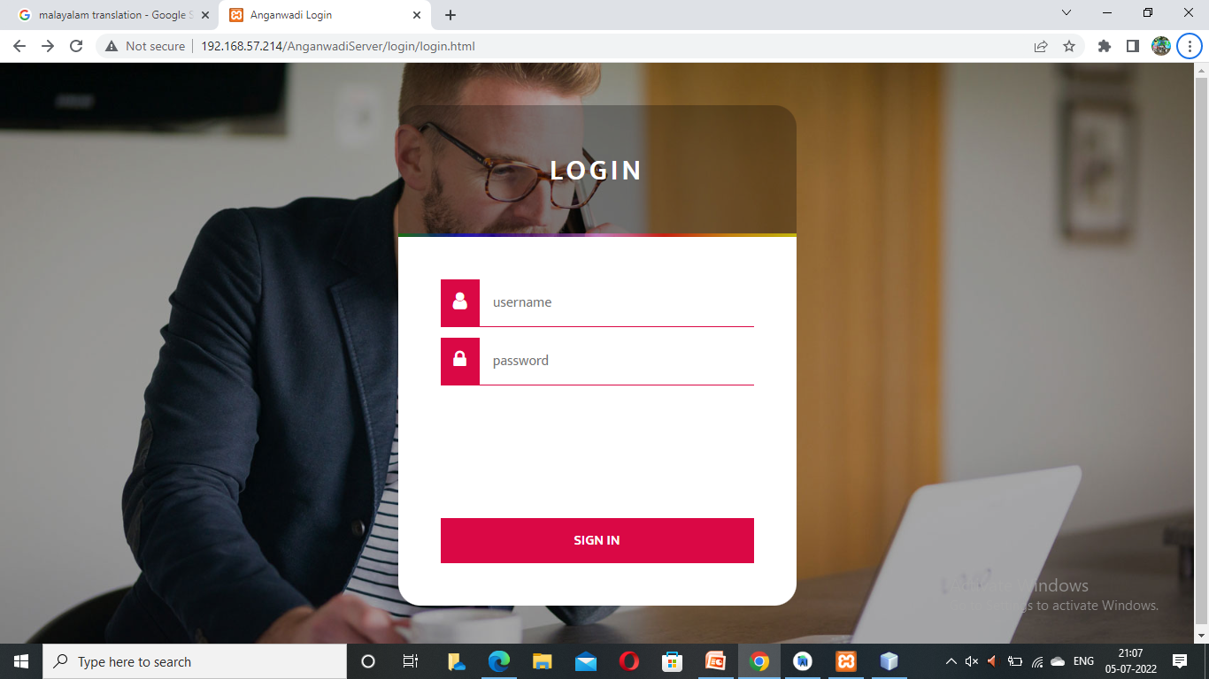
WEB PAGES

Slide 12
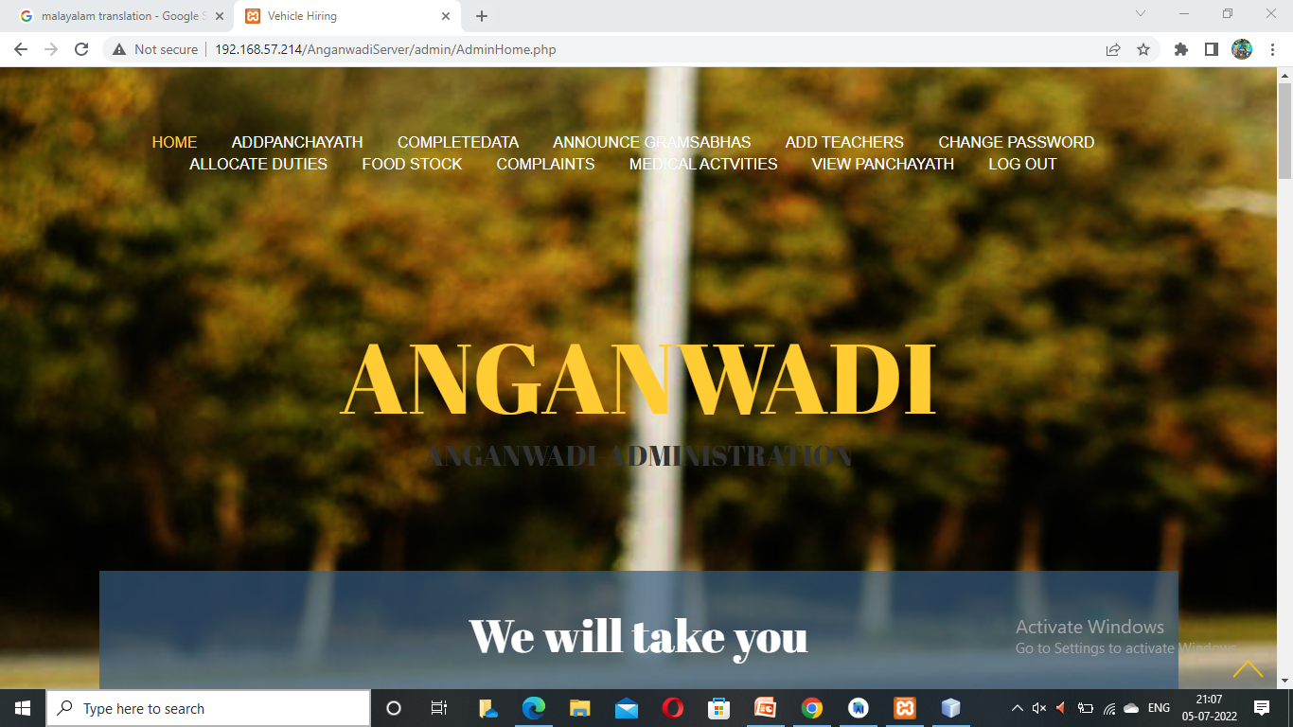

Slide 13
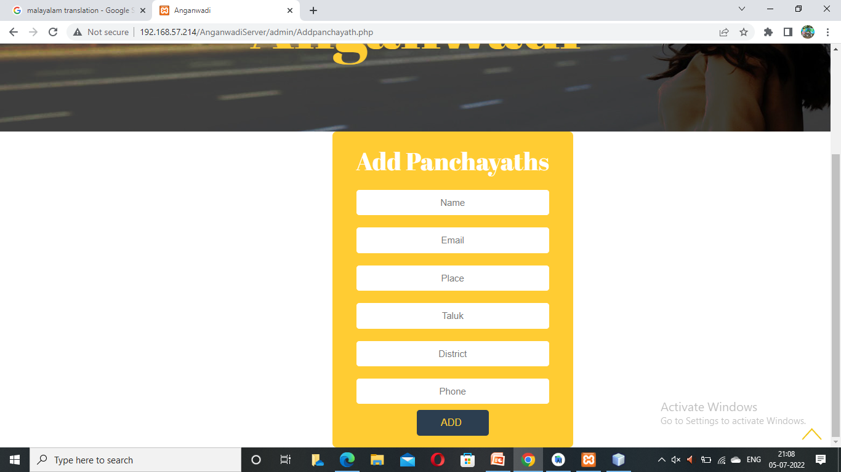

Slide 14
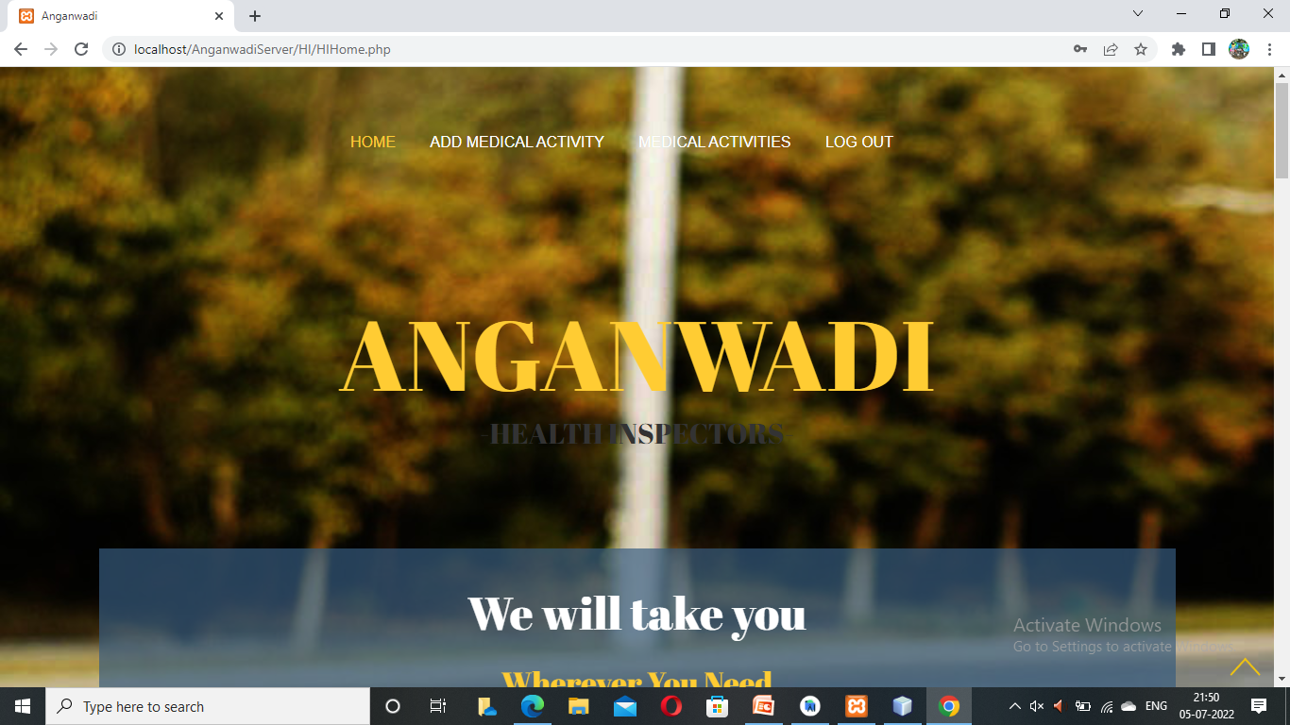

Slide 15
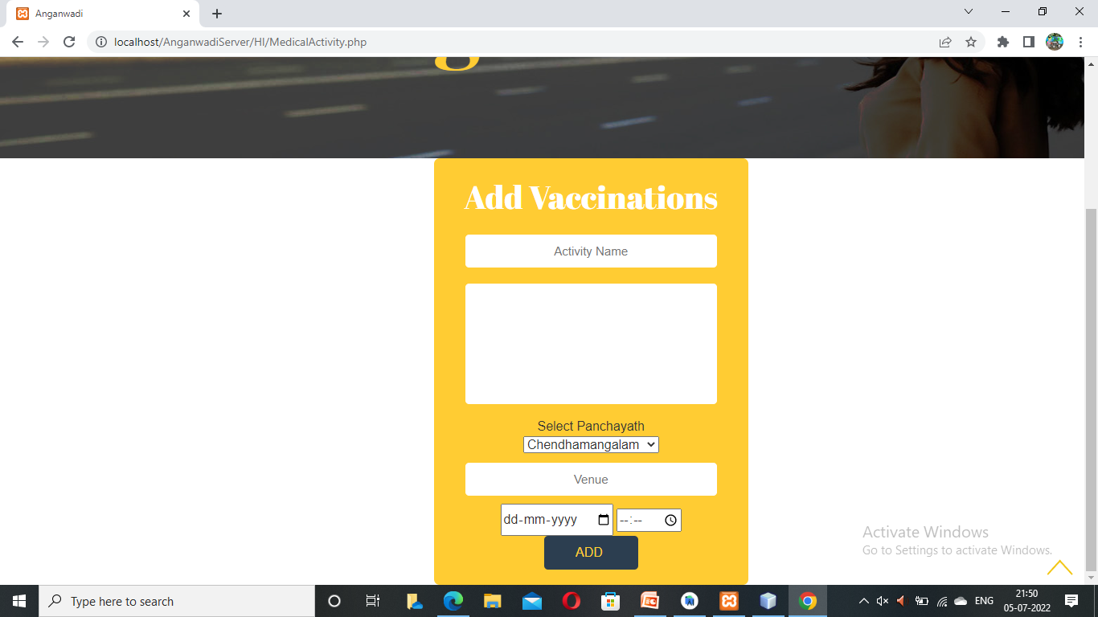

Slide 16
THANK YOU

